Slide 1
ORGANISATION AND TEAM STRUCTURES

Slide 2
ORGANISATION AND TEAM STRUCTURES
Usually every software development organisation handles several projects at any time.
Software organisations assign different teams of developers to handle different software projects.
With regard to staff organisation, there are two important issues—
How is the organisation as a whole structured?
And, how are the individual project teams structured?
There are a few standard ways in which software organisations and teams can be structured.

Slide 3
Organisation Structure
Essentially there are three broad ways in which a software development organisation can be structured
functional format
project format
and matrix format
We discuss these three formats in the following slide

Slide 4
Functional format
In the functional format, the development staff are divided based on the specific functional group to which they belong to.
This format has schematically been shown in Following Figure .
The different projects borrow developers from various functional groups for specific phases of the project and return them to the functional group upon the completion of the phase.
As a result, different teams of programmers from different functional groups perform different phases of a project.
For example, one team might do the requirements specification, another do the design, and so on.

Slide 5
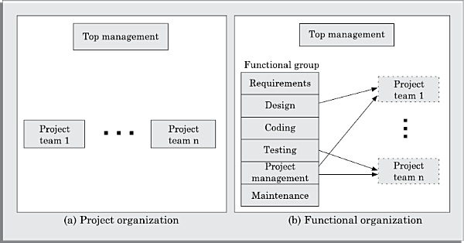
Schematic representation of the functional and project organisation.

Slide 6
Functional format
The partially completed product passes from one team to another as the product evolves.
Therefore, the functional format requires considerable communication among the different teams and development of good quality documents because the work of one team must be clearly understood by the subsequent teams working on the project.
The functional organisation therefore mandates good quality documentation to be produced after every activity.

Slide 7
Project format
In the project format, the development staff are divided based on the project for which they work.
This format has schematically been shown in Figure of slide no 5.
A set of developers is assigned to every project at the start of the project, and remain with the project till the completion of the project.
Thus, the same team carries out all the life cycle activities.
An advantage of the project format is that it provides job rotation.
That is, every developer undertakes different life cycle activities in a project.

Slide 8
Project format
However, it results in poor manpower utilisation, since the full project team is formed since the start of the project, and there is very little work for the team during the initial phases of the life cycle.

Slide 9
Functional versus project formats
Even though greater communication among the team members may appear as an avoidable overhead, the functional format has many advantages.
The main advantages of a functional organisation are:
Ease of staffing
•Production of good quality documents
Job specialisation
Efficient handling of the problems associated with manpower turnover.

Slide 10
Functional versus project formats
The functional organisation allows the developers to become specialists in particular roles, e.g. requirements analysis, design, coding, testing, maintenance, etc.
They perform these roles again and again for different projects and develop deep insights to their work.
It also results in more attention being paid to proper documentation at the end of a phase because of the greater need for clear communication as between teams doing different phases.
The functional organisation also provides an efficient solution to the staffing problem.

Slide 11
Functional versus project formats
The staffing pattern should approximately follow the Rayleigh distribution for efficient utilisation of the personnel by minimizing their wait times.
The project staffing problem is eased significantly because personnel can be brought onto a project as needed, and returned to the functional group when they are no more needed.
This possibly is the most important advantage of the functional organisation.

Slide 12
Functional versus project formats
A project organisation structure forces the manager to take in almost a constant number of developers for the entire duration of his project.
This results in developers idling in the initial phase of software development and are under tremendous pressure in the later phase of development.
A further advantage of the functional organisation is that it is more effective in handling the problem of manpower turnover.
This is because developers can be brought in from the functional pool when needed.

Slide 13
Functional versus project formats
Also, this organisation mandates production of good quality documents, so new developers can quickly get used to the work already done.
In spite of several important advantages of the functional organisation, it is not very popular in the software industry.
This apparent paradox is not difficult to explain.
We can easily identify the following three points:

Slide 14
Functional versus project formats
We can easily identify the following three points:
1.The project format provides job rotation to the team members.That is, each team member takes on the role of the designer, co der, tester, etc during the course of the project.
On the other hand, considering the present skill shortage, it would be very difficult for the functional organisations to fill slots for some roles such as the maintenance, testing, and coding groups.

Slide 15
Functional versus project formats
2. Another problem with the functional organisation is that if an organisation handles projects requiring knowledge of specialized domain areas, then these domain experts cannot be brought in and out of the project for the different phases, unless the company handles a large number of such projects.
3. For obvious reasons the functional format is not suitable for small organisations handling just one or two projects.

Slide 16
Matrix format
A matrix organisation is intended to provide the advantages of both functional and project structures.
In a matrix organisation, the pool of functional specialists are assigned to different projects as needed.
Thus, the deployment of the different functional specialists in different projects can be represented in a matrix (see in following figure )
In Figure , it is observe that different members of a functional specialisation are assigned to different projects.

Slide 17
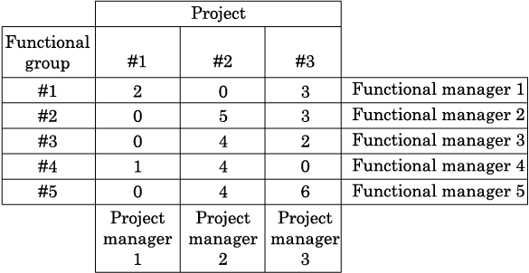
Fig:Matrix organisation

Slide 18
Matrix format
Therefore in a matrix organisation, the project manager needs to share responsibilities for the project with a number of individual functional managers.
Matrix organisations can be characterised as weak or strong, depending upon the relative authority of the functional managers and the project managers.
In a strong functional matrix, the functional managers have authority to assign workers to projects and project managers have to accept the assigned personnel.
In a weak matrix, the project manager controls the project budget, can reject workers from functional groups, or even decide to hire outside workers.

Slide 19
Problem with Matrix Format.
Two important problems that a matrix organisation often suffers from are:
Conflict between functional manager and project managers over allocation of workers.
Frequent shifting of workers in a firefighting mode as crises occur in different projects.

Slide 20
Any Question?

Slide 21
Thank You

